Slide 1
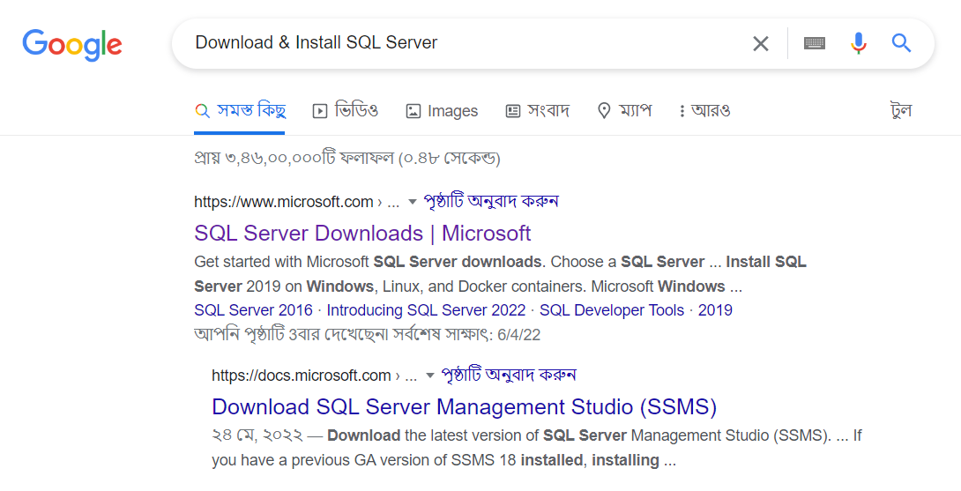
Download SQL Server

Slide 2
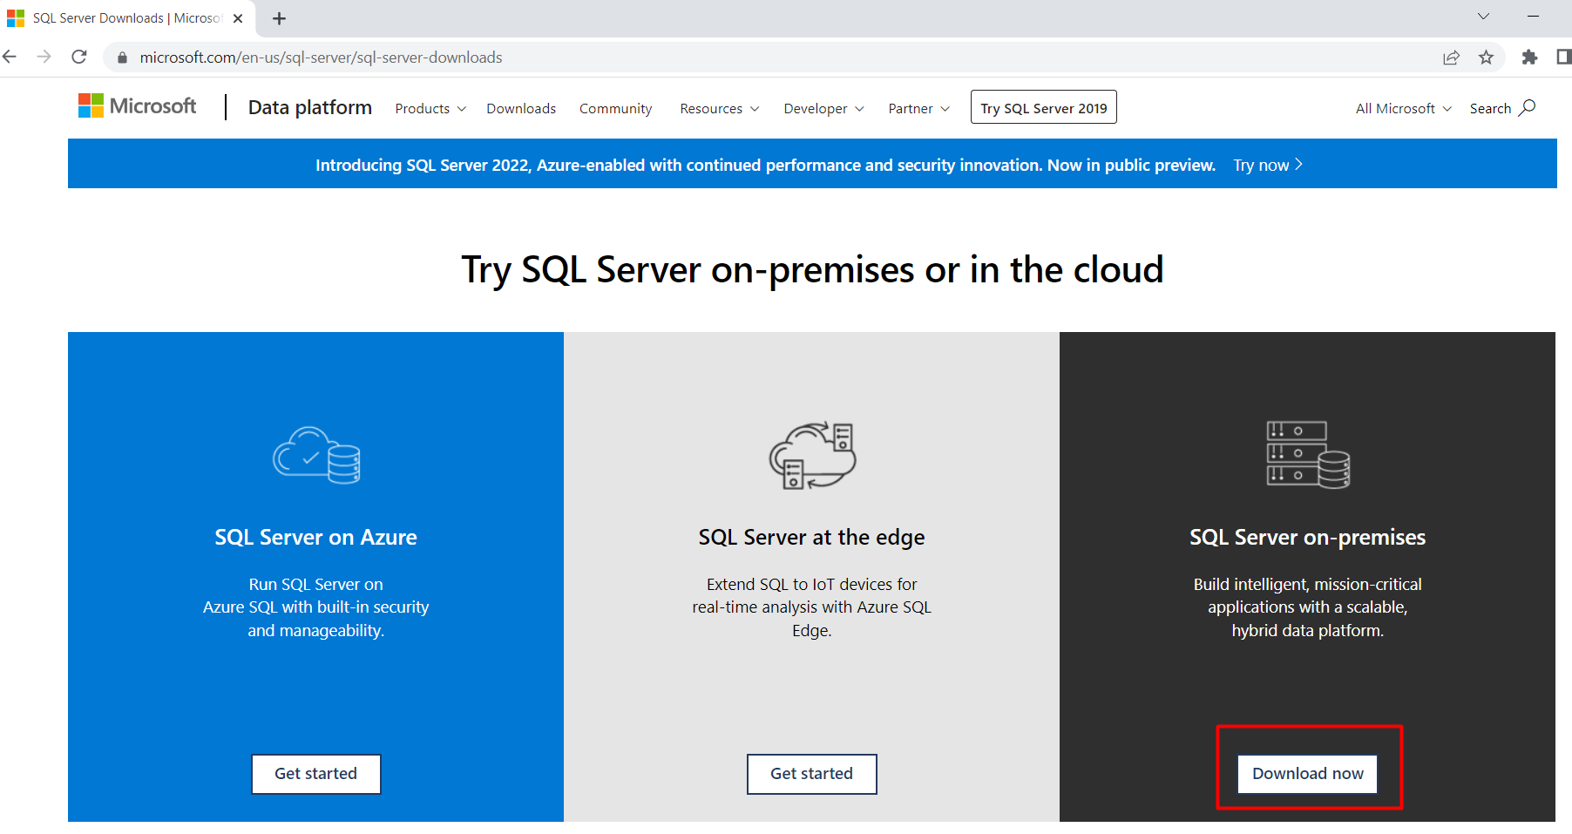
Download SQL Server

Slide 3
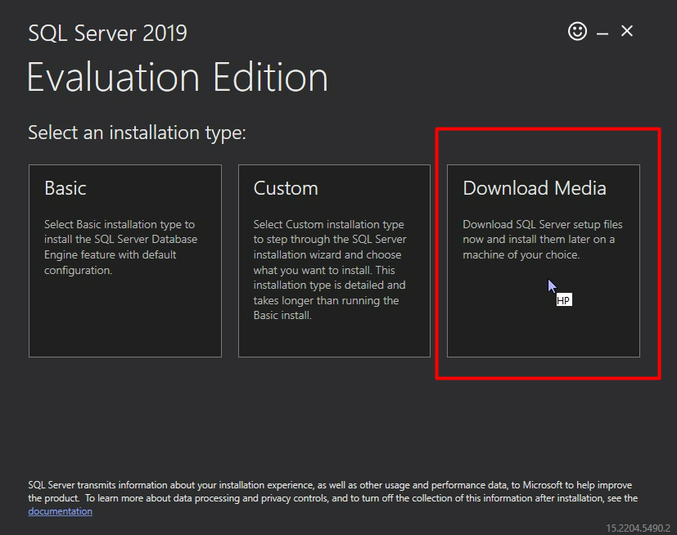
Download SQL Server

Slide 4
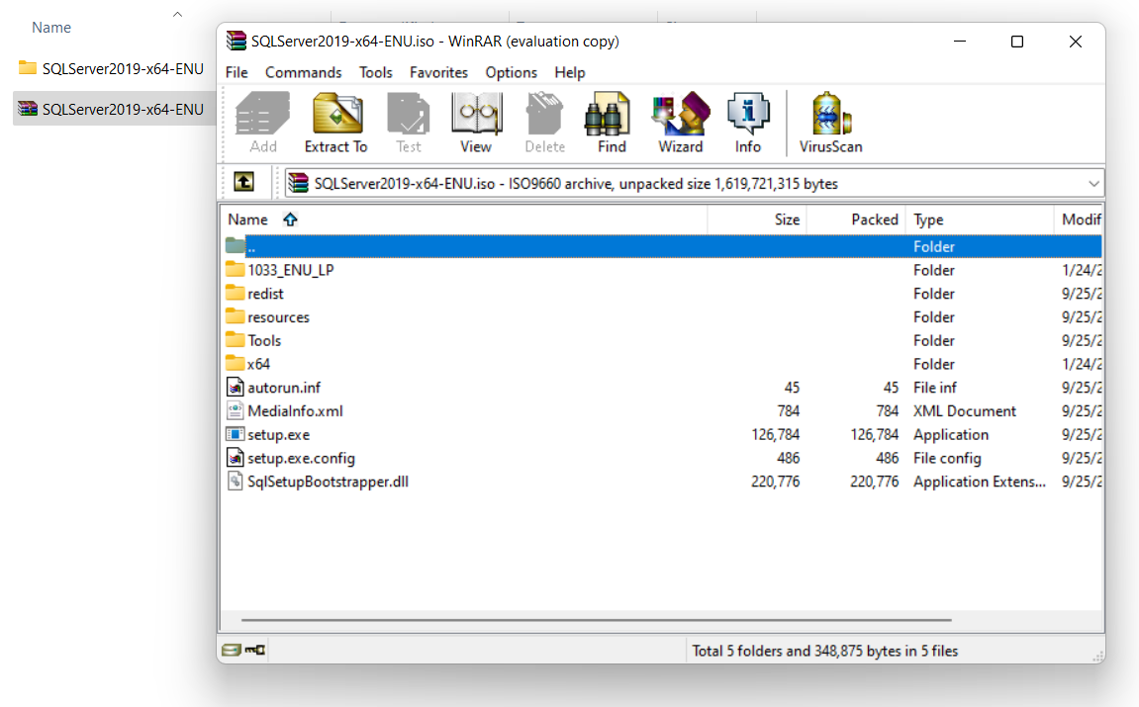
Unzip the ISO file

Slide 5
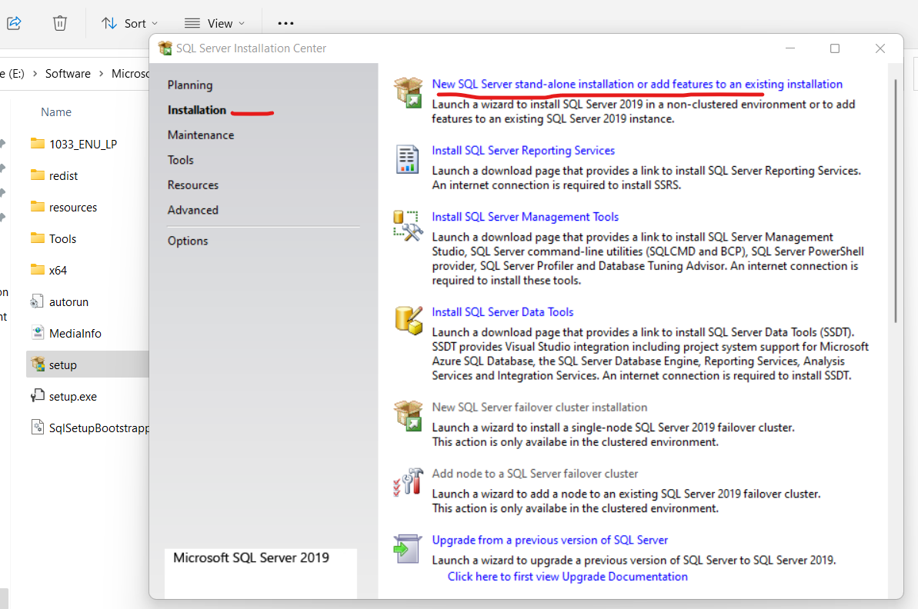
Installation SQL Server

Slide 6
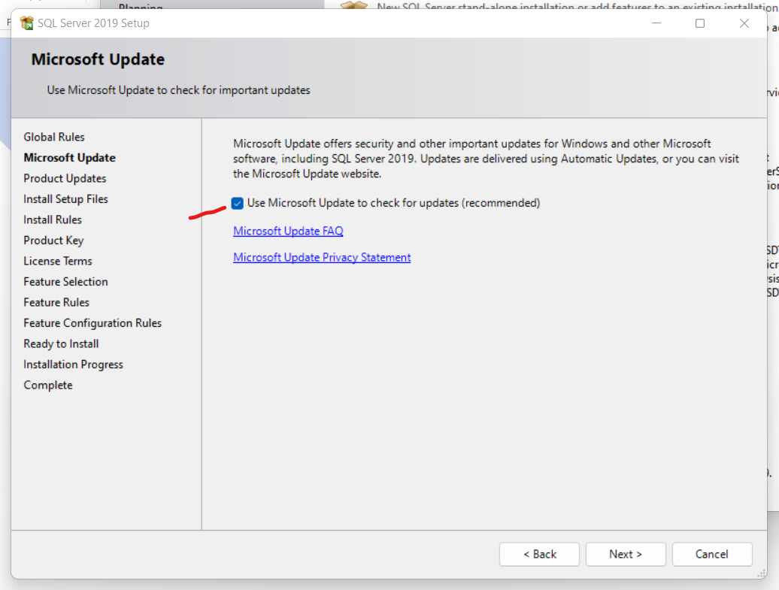
Installation SQL Server

Slide 7
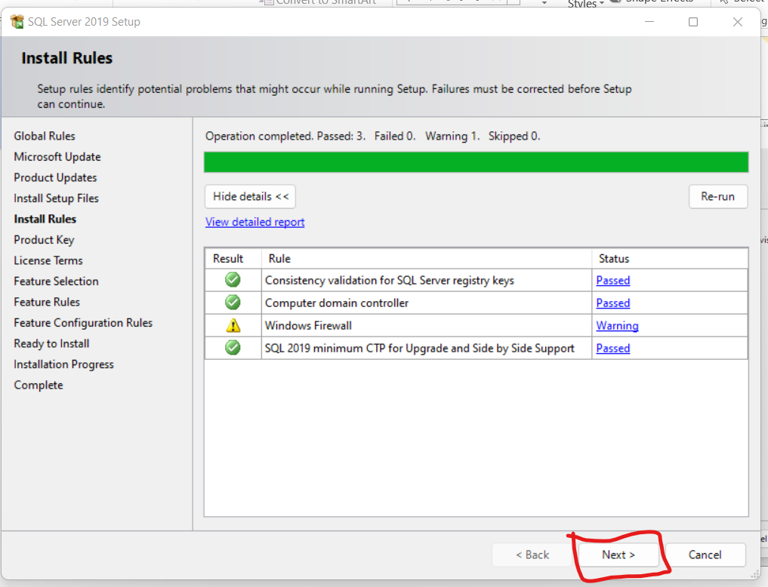
Installation SQL Server

Slide 8
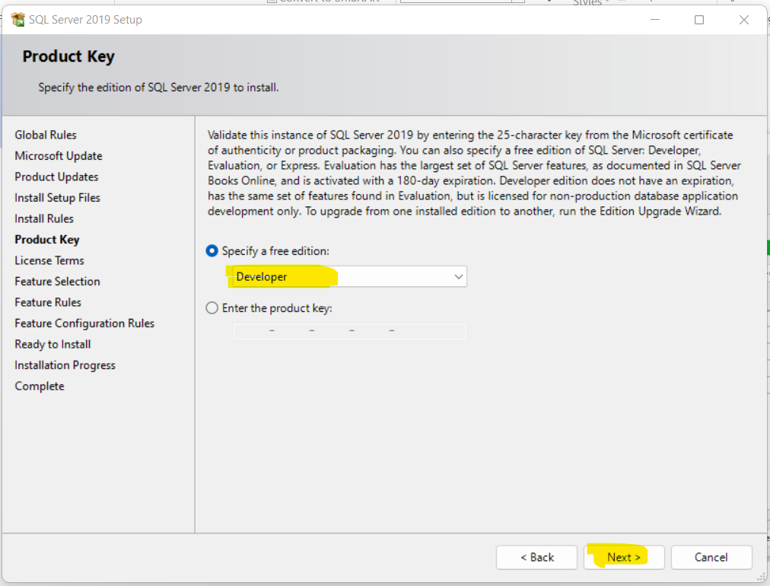
Installation SQL Server

Slide 9
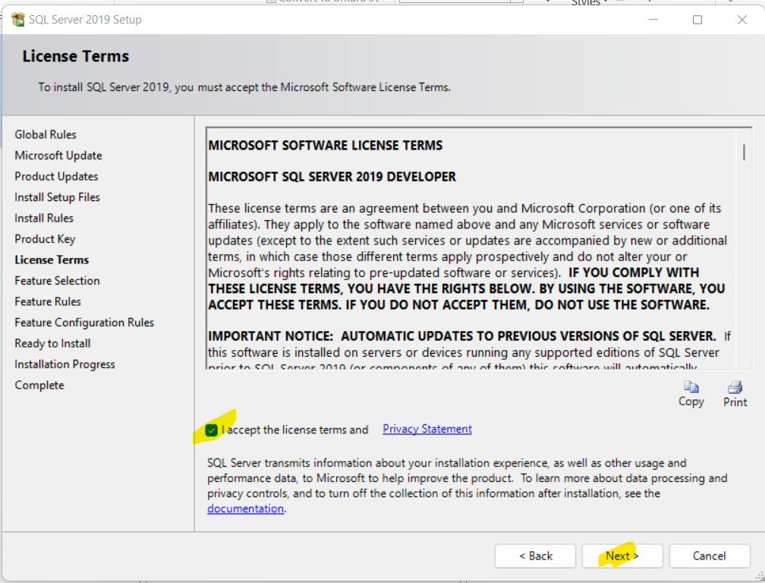
Installation SQL Server

Slide 10
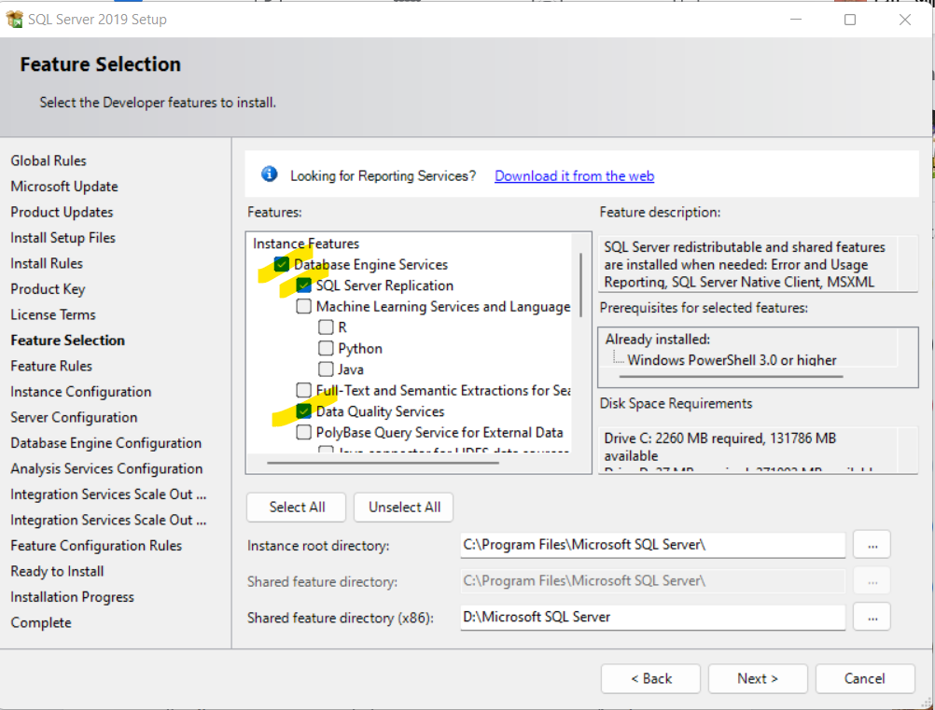
Installation SQL Server

Slide 11
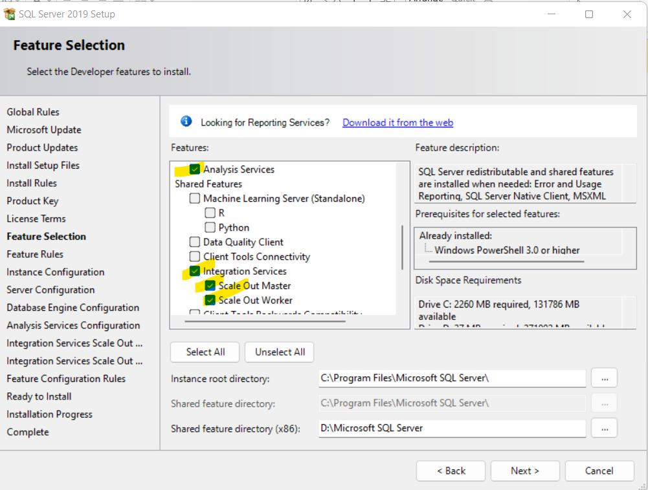
Installation SQL Server

Slide 12
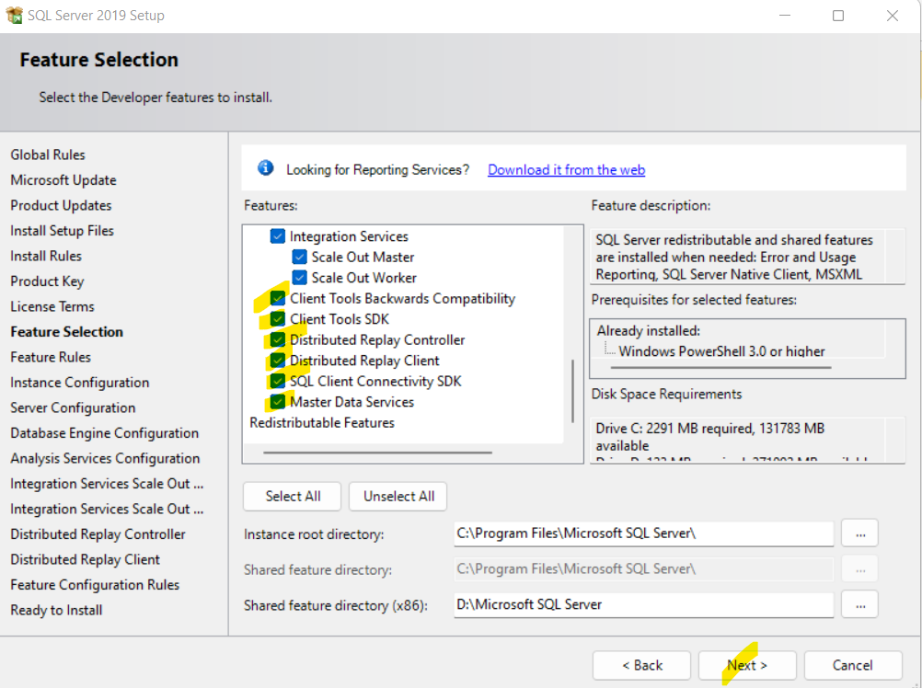
Installation SQL Server

Slide 13
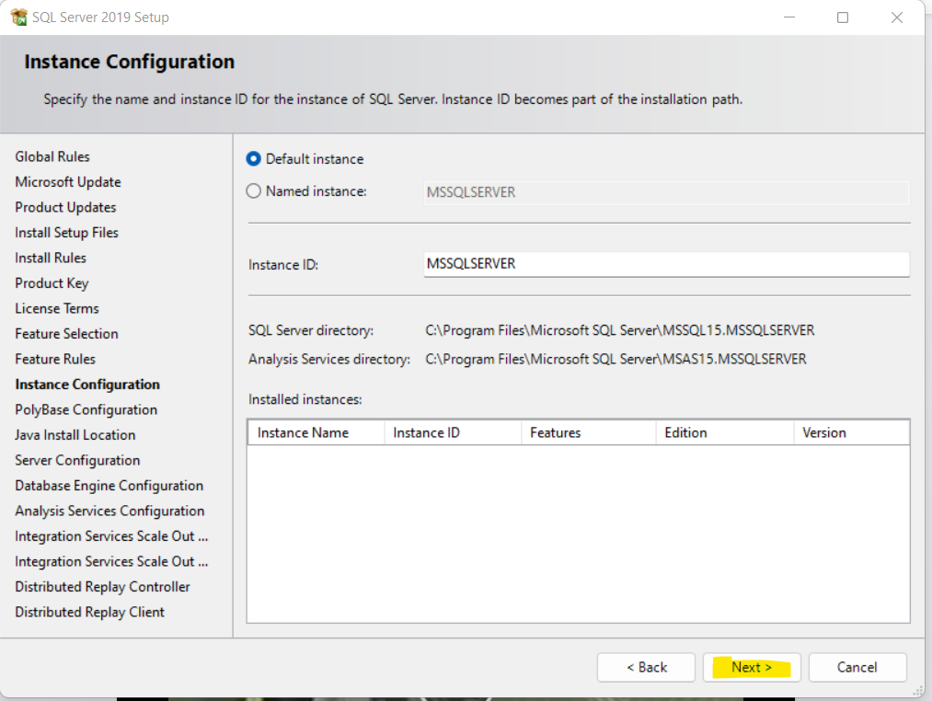
Installation SQL Server

Slide 14
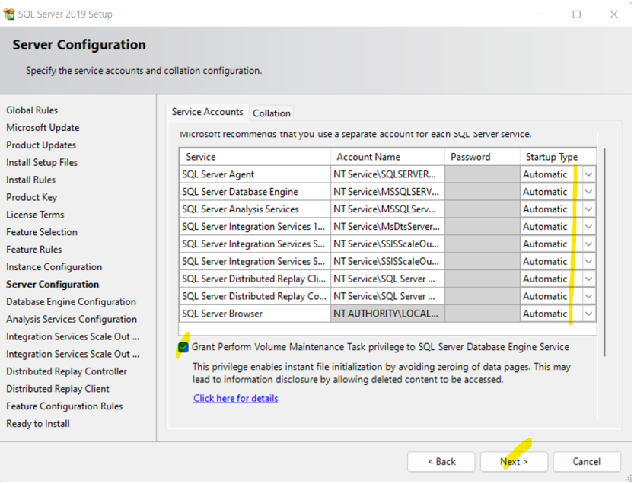
Installation SQL Server

Slide 15
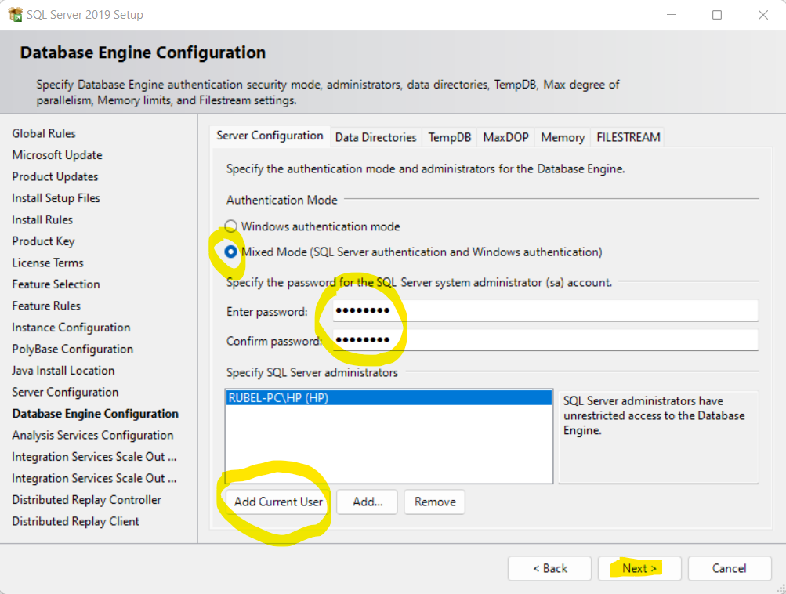
Installation SQL Server

Slide 16
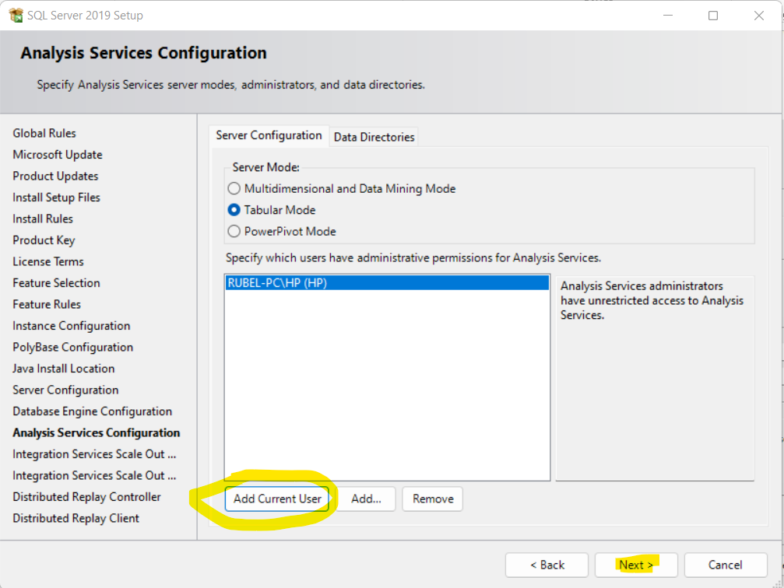
Installation SQL Server

Slide 17
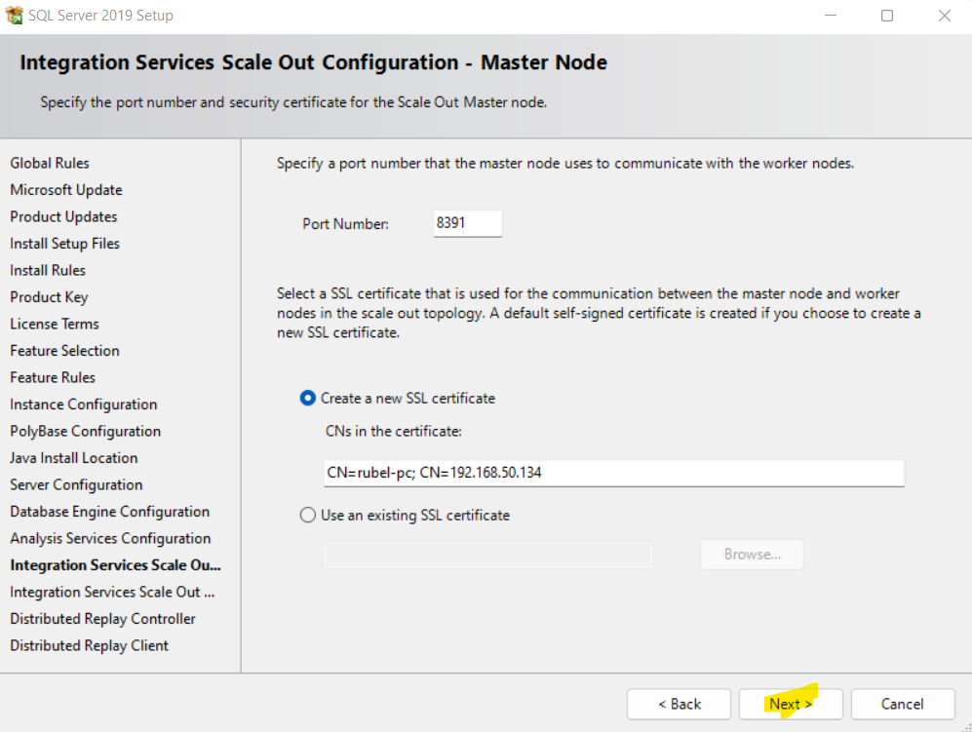
Installation SQL Server

Slide 18
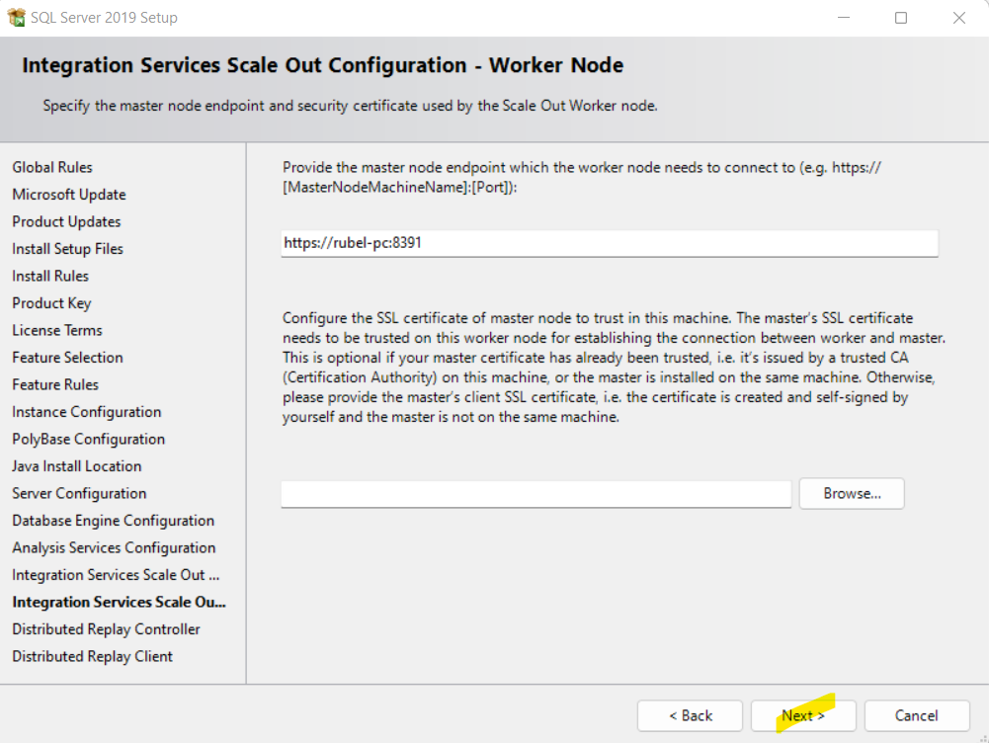
Installation SQL Server

Slide 19
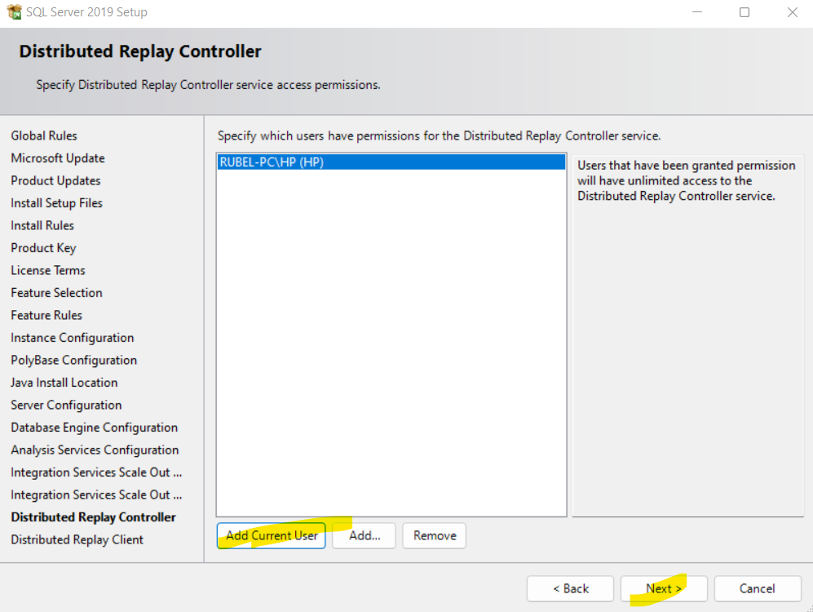
Installation SQL Server

Slide 20
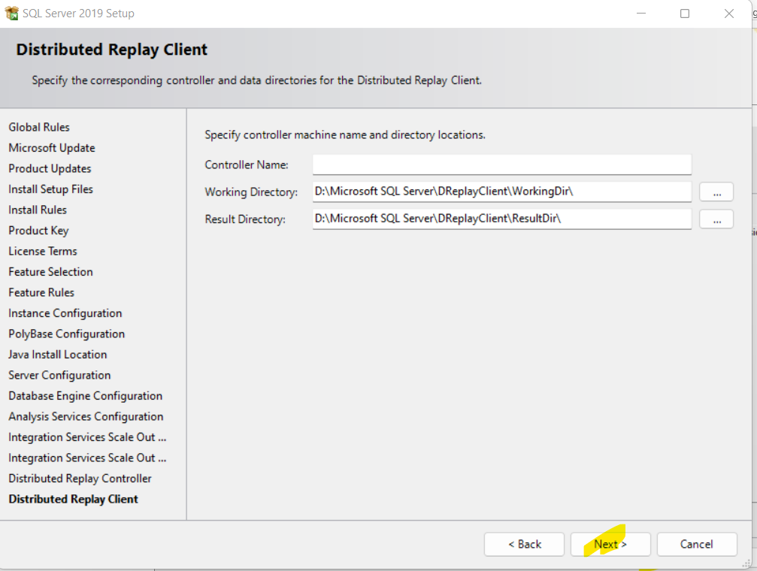
Installation SQL Server

Slide 21
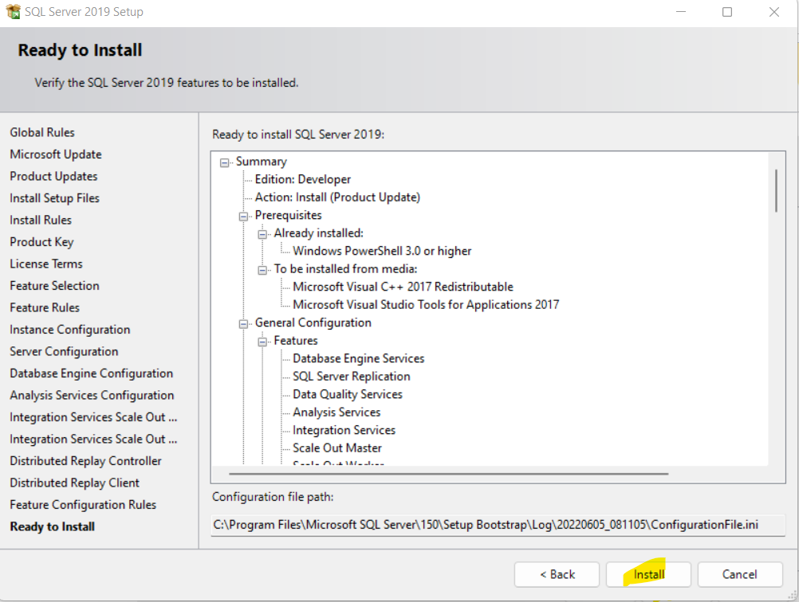
Installation SQL Server

Slide 22
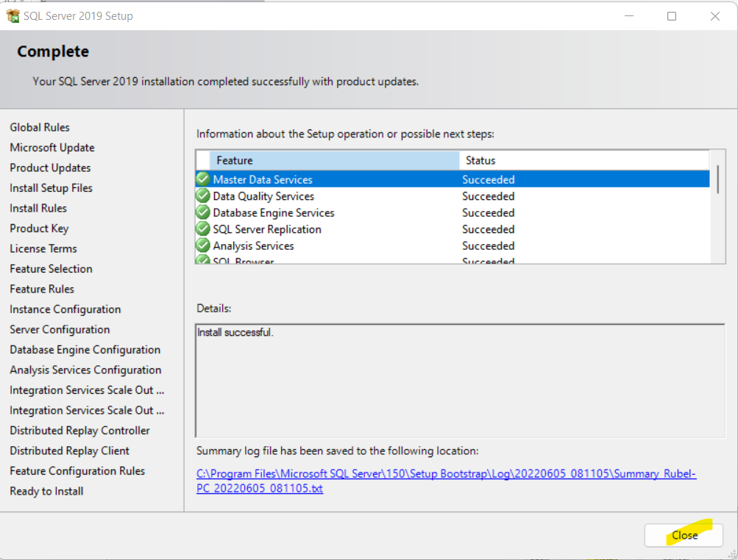
Installation SQL Server

Slide 23
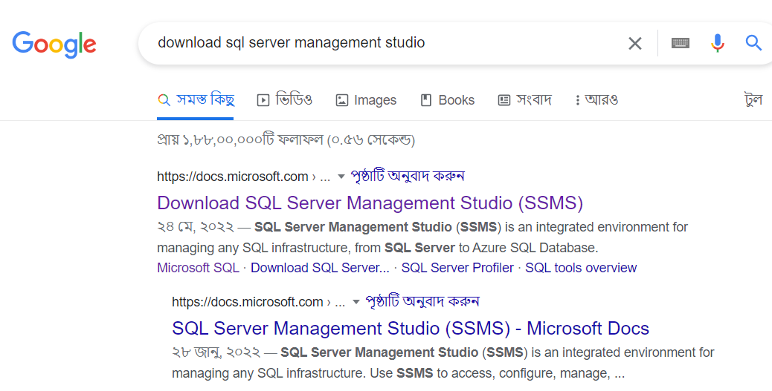
Download SQL Server Management Studio

Slide 24
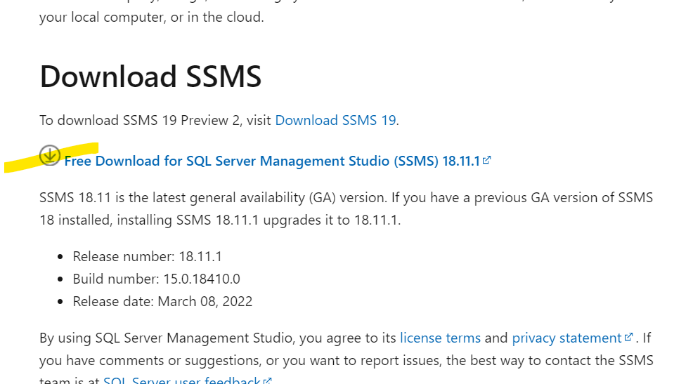
Download SQL Server Management Studio

Slide 25
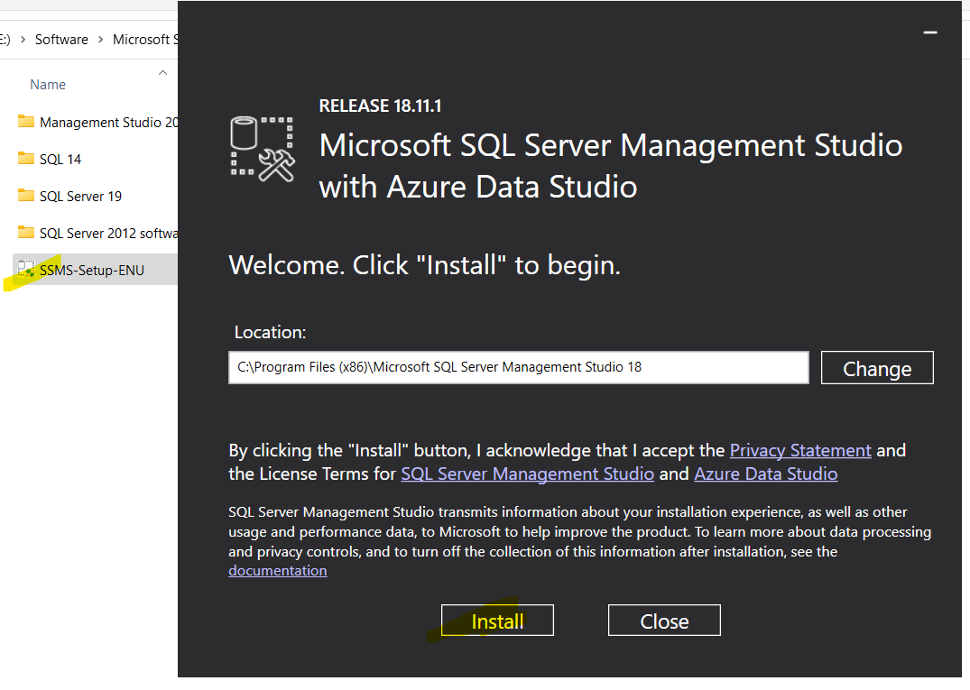
Installation SQL Server Management Studio

Slide 26
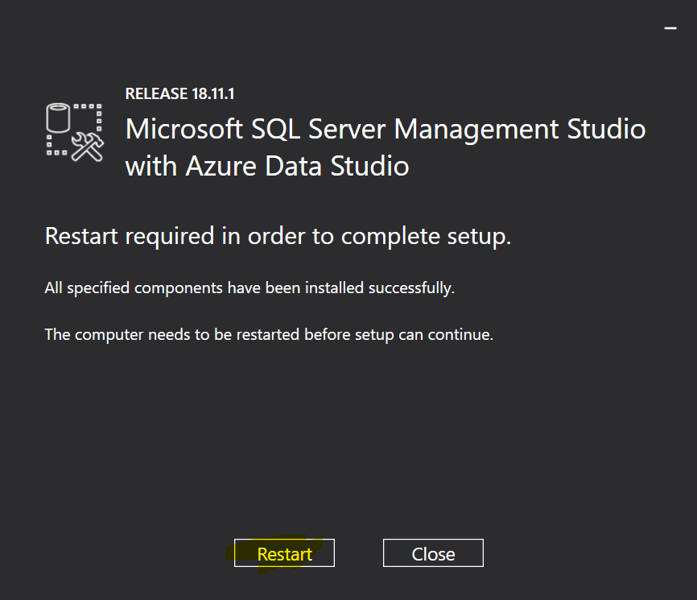
Installation SQL Server Management Studio

Slide 27
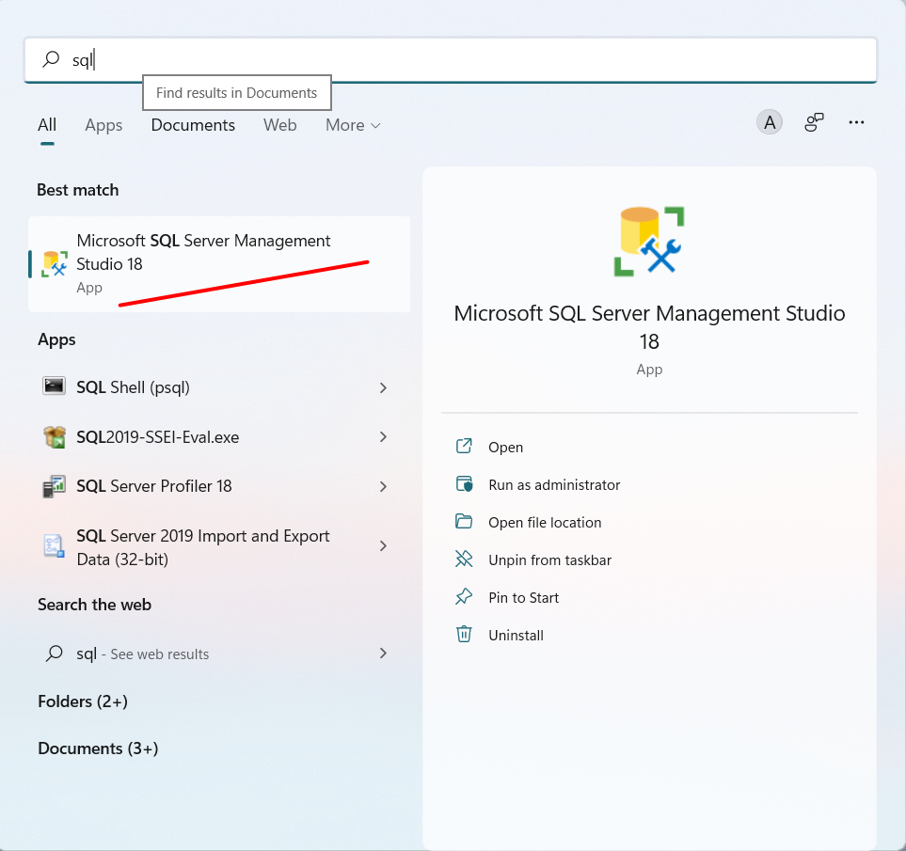
Running SQL Server Management Studio

Slide 28
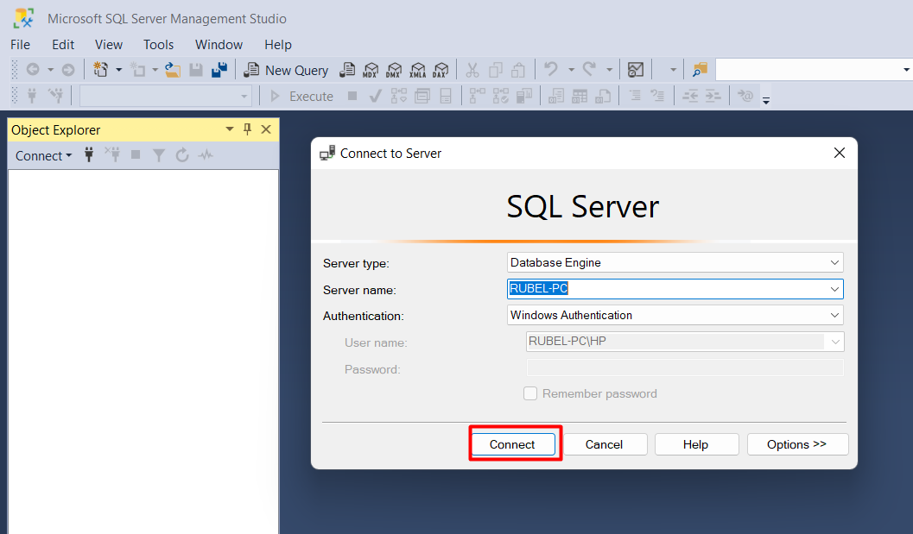
Running SQL Server Management Studio

